Slide 1
Unit- 4
Color Image Processing: Human perception of color, color models - RGB, CMY, HSI, The chromaticity diagram, Pseudo-color.

Slide 2
Background
The use of color in image processing is motivated by two principal factors.
First, color is a powerful descriptor that often simplifies object identification and extraction from a scene.
Second, Humans can perceive thousands of colors, and only about a couple of dozen gray shades.
Color Image Processing is divided into two major area-
Full-color processing – the images are acquired with a full color sensor, such as color TV camera or color scanner
Pseudo-color processing – assigning a color to a particular monochrome intensity or range of intensities.
Some of the gray-scale methods are directly applicable to color images.

Slide 3
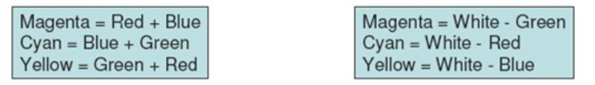
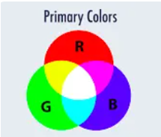
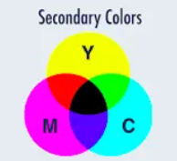
Color Fundamentals
Primary colors– Red, Green, and Blue.
The primary colors can be added together to produce the secondary colors – magenta, cyan and yellow
Mixing the three primaries or a secondary with its opposite primary color in the right intensity produces white light (e.g. red+cyan).
As indicated cyan, magenta and Yellow are the secondary colors of light, alternatively, the primary colors of pigments (which have red, green, and blue as secondary colors)

Slide 4
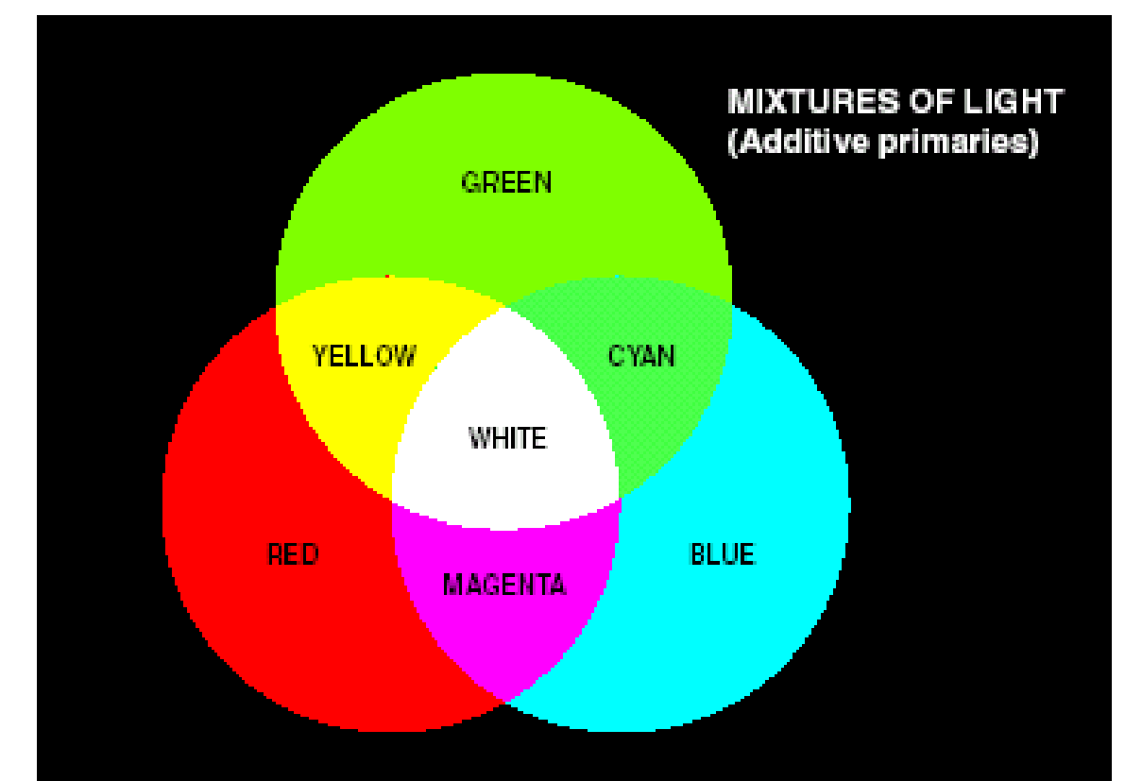
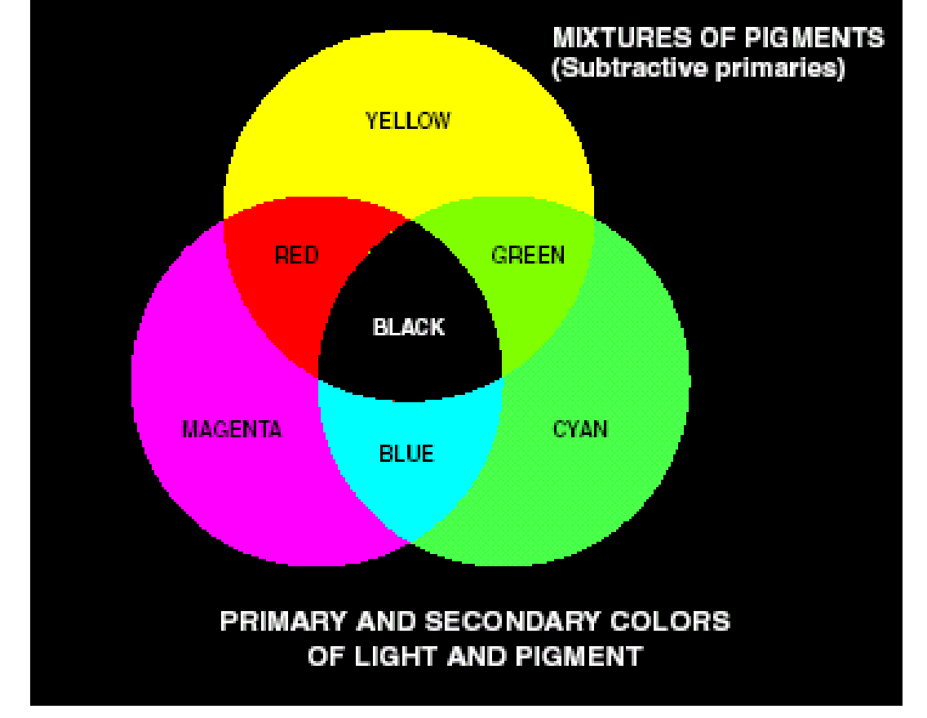
Color Fundamentals
Important difference: Differentiating between primary colors of light(RGB) and primary colors of pigments (CMY) or colorants is important.
Primary color of pigment- A primary color is defined as one that subtracts or absorbs a primary color of light and reflects or transmits the other two.
Therefor the primary colors of pigment are magenta, cyan and yellow and the secondary colors of pigment are red, green and blue.
A proper combination of the three pigment primaries , or a secondary with its opposite primary , produces BLACK.

Slide 5
The additive and subtractive color models
The additive and subtractive color models are two ways of creating color by mixing different primary colors, but they work in opposite ways:
1. Additive Color Model (RGB Model)
Primary Colors: Red, Green, Blue
How it works: In the additive color model, colors are created by adding light together. The more light you add, the closer the result is to white. This model is used in digital screens (like monitors, TVs, and projectors) where colors are formed by mixing red, green, and blue light at different intensities.
Key Concept: Adding all the colors together in full intensity (Red + Green + Blue) creates white light.
Example:
Red + Green = Yellow
Green + Blue = Cyan
Blue + Red = Magenta
Red + Green + Blue = White
Used in: Screens, digital displays, stage lighting.

Slide 6
2. Subtractive Color Model (CMY and CMYK Models)
Primary Colors: Cyan, Magenta, Yellow (and sometimes Key/Black for CMYK)
How it works: In the subtractive color model, colors are created by subtracting light. This model is used in printing, where colors are mixed by absorbing (subtracting) certain wavelengths of light. The primary colors absorb certain wavelengths, and the reflected light is what you see.
Key Concept: Subtracting all colors (Cyan + Magenta + Yellow) theoretically produces black, but in practice, it results in a muddy brown, so black (Key) is added in the CMYK model for better depth and contrast.
Example:
Cyan + Magenta = Blue
Magenta + Yellow = Red
Yellow + Cyan = Green
Cyan + Magenta + Yellow = Black (or near black with a deeper combination)
Used in: Printing, painting, photography.
Summary of Differences:
Additive: Light-based, RGB (screens, monitors).
Subtractive: Pigment-based, CMY(CK) (printing, painting).

Slide 7
Color Fundamentals
The characteristics generally used to distinguish one color from another are Brightness, Hue, and Saturation.
Hue: Represents dominant color as perceive by an observer.
Saturation: Relative purity or the amount of white light mixed with a hue.
Hue and saturation taken together are called Chromaticity, and therefore, a color may be characterized by its Brightness and Chromaticity

Slide 8
CIE Chromaticity Diagram
The CIE Chromaticity Diagram is a graphical representation of colors visible to the human eye, based on the CIE 1931 color space developed by the Commission Internationale de l'Éclairage (CIE). It maps the chromaticity of colors using two parameters, x and y, derived from the CIE XYZ color space.
Key Features of the CIE Chromaticity Diagram:
Horseshoe Shape – The diagram has a curved boundary representing the pure spectral colors (monochromatic light), from violet (~380 nm) to red (~700 nm).
White Point – The center area represents white light, which is a mix of all visible wavelengths.
Purple Line – The straight-line segment connecting extreme blue and red, representing colors that cannot be produced by a single wavelength (e.g., magenta).
Gamut Representation – The diagram is used to illustrate color gamuts of different devices (monitors, printers, etc.), showing the range of colors they can reproduce.
Complementary Colors – Any two colors on the diagram that mix to form white light are complementary.

Slide 9
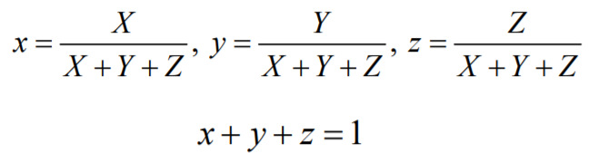
CIE Chromaticity Diagram
The amounts of red, green and blue needed to form a particular color are called tristimulus values and are denoted by X, Y, Z.
A color is then specified by its trichromatic coefficients:

Slide 10
CIE Chromaticity Diagram
Specifying colors systematically can be achieved using the CIE chromaticity diagram. This is an international standard for primary colors established in 1931. It allows all other colors to be defined as weighted sum of the three "primary" colors. There are no real three colors that can be combined to give all possible colors.
On this diagram the x-axis represents the proportion of red and the y-axis represents the proportion of green used to produce a specific color.
The proportion of blue used in a color is calculated as:
z = 1 – (x + y)

Slide 11
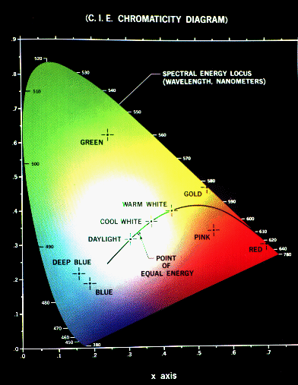
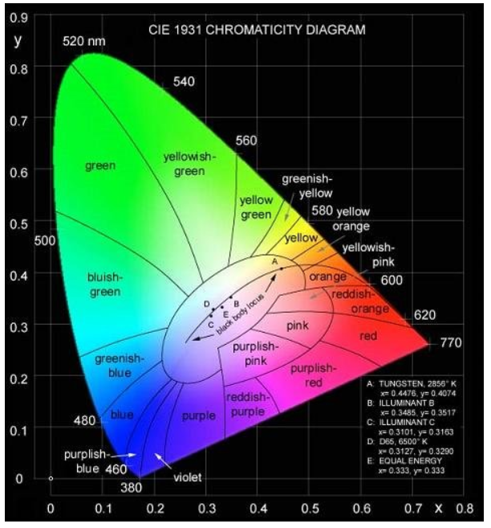
CIE Chromaticity Diagram
The pure colors of the spectrum lie on the curved part of the boundary, and a standard white light has color defined to be near (but not at) the point of equal energy x = y = z = ¹/₃

Slide 12
CIE Chromaticity Diagram
Any color located on the boundary of the chromaticity chart is fully saturated (Pure colors).
The point of equal energy (PEE) has equal amounts of red, green and blue.
– It is the CIE standard for pure white.

Slide 13
CIE Chromaticity Diagram
Any straight line joining two points in the diagram defines all the different colors that can be obtained by combining these two colors additively.
A line drawn from the PEE to any point on the boundary defines all the shades of that particular color.

Slide 14
What is the color model??
The color model aims to facilitate the specifications of colors in some standard way.
Different types of color models are used in multiple fields like in hardware, in multiple applications of creating animation, etc
In Digital Image Processing, the hardware-oriented models that are commonly used are the RGB model for printers and color monitors.
CMY(cyan, magenta, yellow) and CMYK(cyan, magenta, yellow, black) models are used for color printing.
HSI(hue, saturation, intensity) deals with colors as humans interpret.

Slide 15
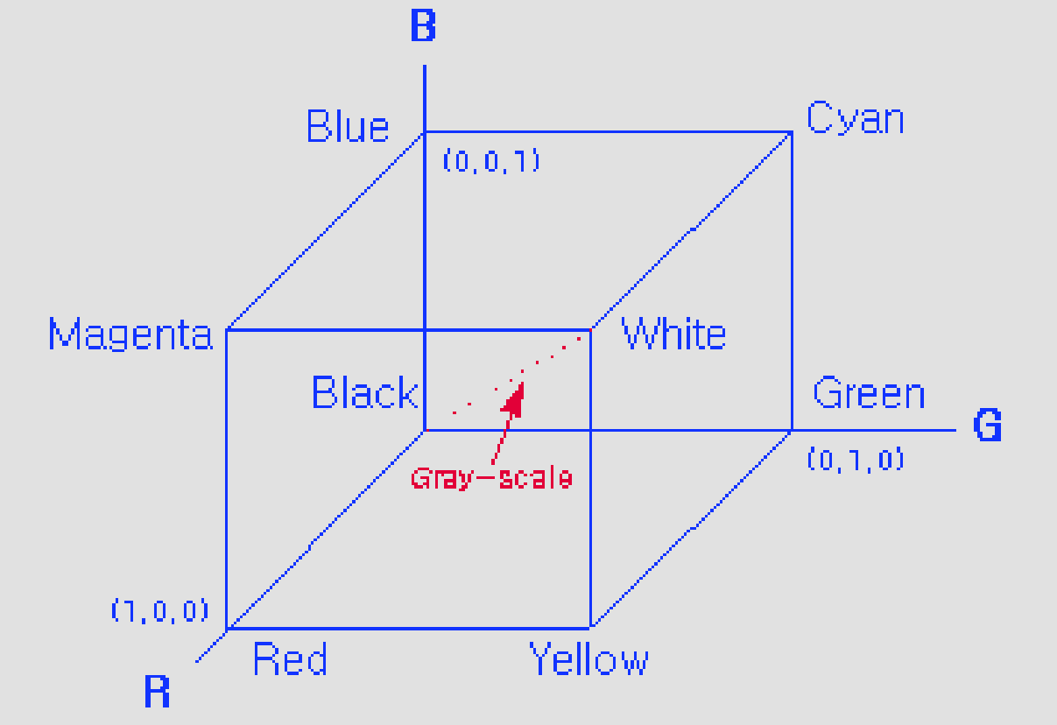
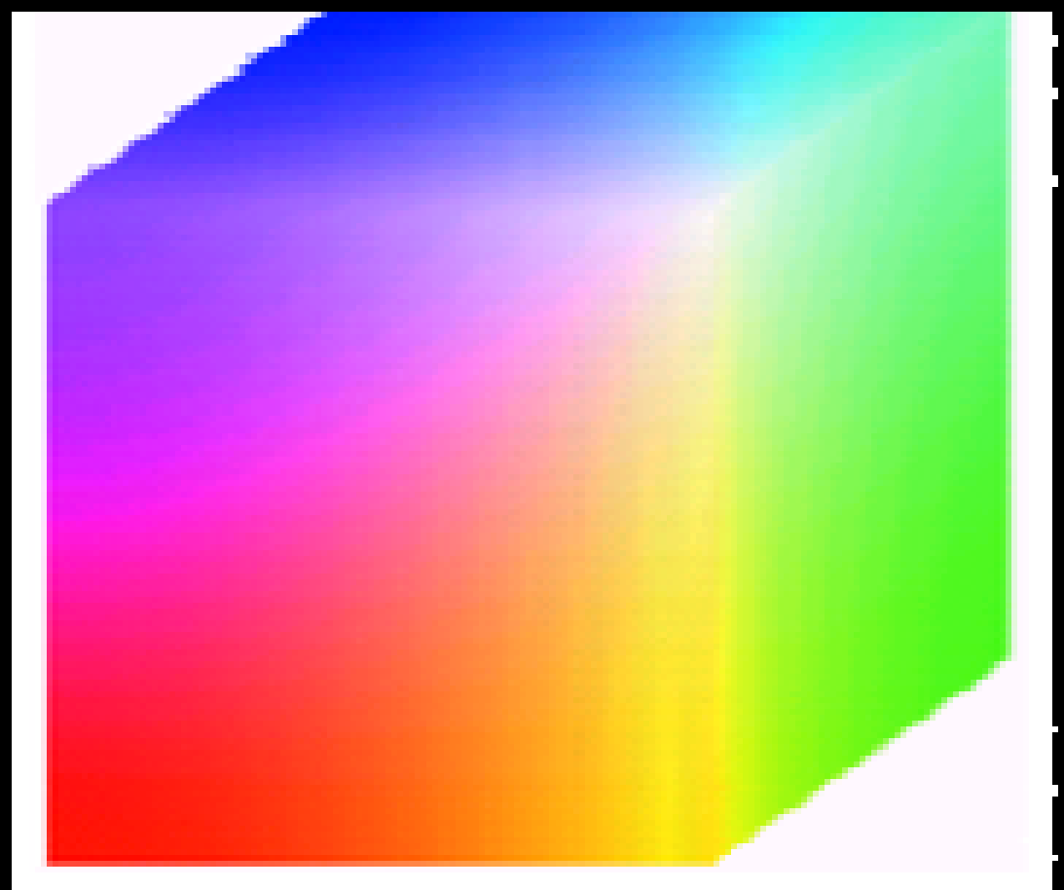
Color Image Representation
RGB Model –
RGB values are at 3 corners.
Cyan magenta and yellow are at three other corners.
Black is at the origin.
White is the corner furthest from the origin.
Different colors are points on or inside the cube represented by RGB vectors.

Slide 16
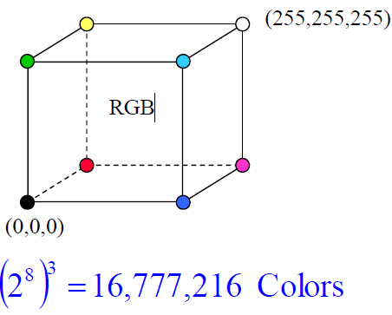
Color Image Representation
Usually, we specify the levels of R, G and B in the range [0, 255], (8-bit integers).
Images represented in the RGB color model consist of three component images – one for each primary color.
The number of bits used to represent each pixel is referred to as the color depth.

Slide 17
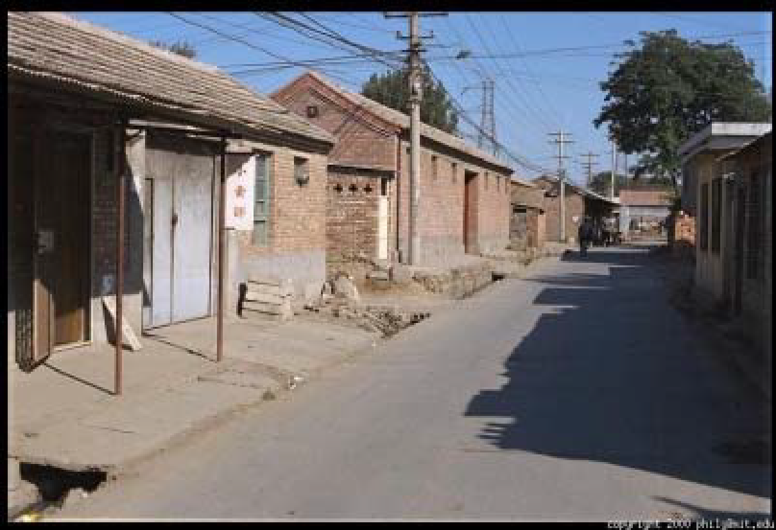
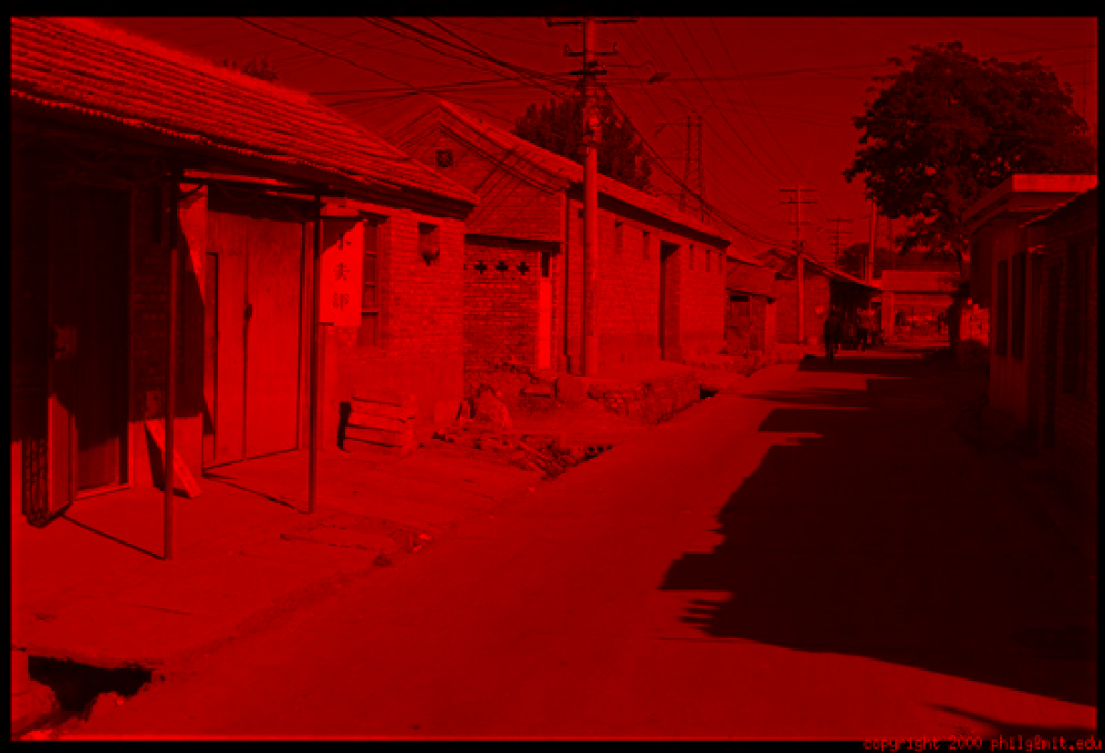
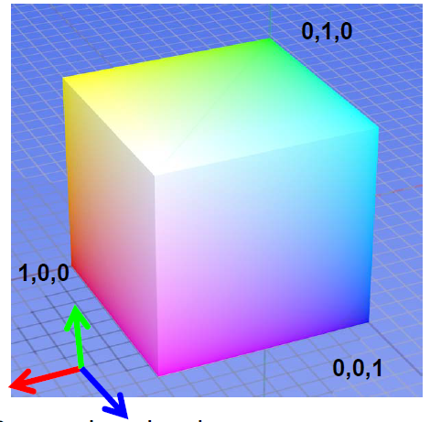
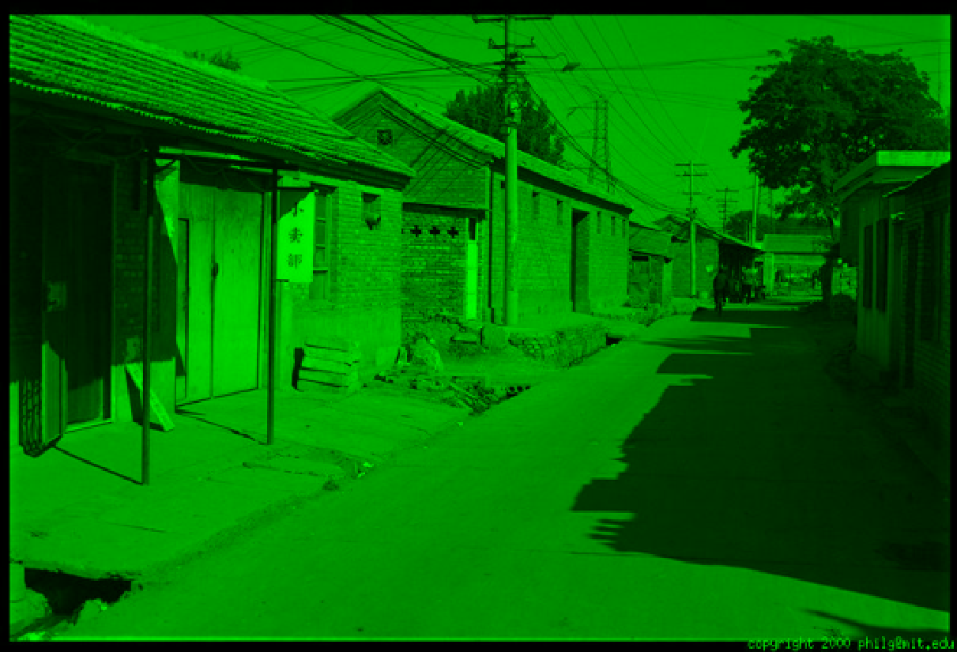
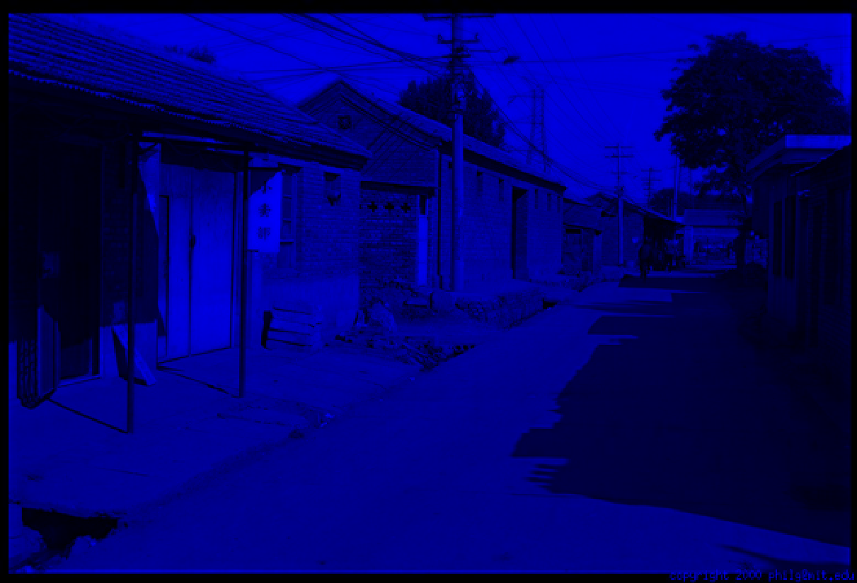
Color Image Representation
Default color space-
R
(G=0,B=0)
G
(R=0,B=0)
B
(R=0,G=0)

Slide 18
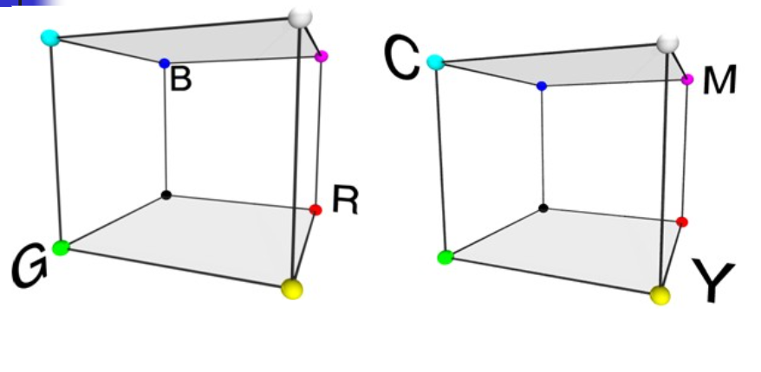
RGB and CMY

Slide 19
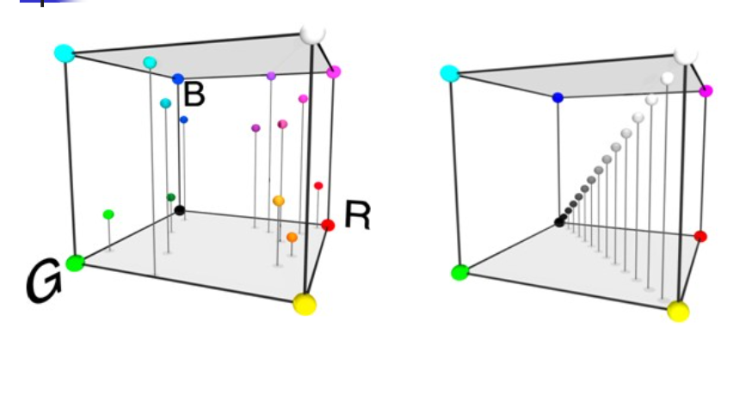
RGB and CMY

Slide 20
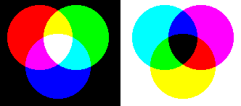
The CMY Model
The figure on the left shows the additive mixing of red, green and blue primaries to form the three secondary colors-
yellow (red + green),
cyan (blue + green),
magenta (red + blue), and
white ((red + green + blue).
The figure on the right shows the three subtractive primaries, and their pairwise combinations to form red, green and blue, and finally black by subtracting all three primaries from white.

Slide 21
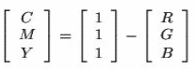
CMY Model
This model contains the secondary colors.
In this model, any secondary color when passed through white light will not reflect the color from which a combination of colors is made.
For example- when cyan is illuminated with white light, no red light will be reflected from the surface which means that the cyan subtracts the red light from the reflected white light (which itself is composed of red, green and white light).
The formula given is for inter-conversion of RGB and CMY models.

Slide 22
CMY Model
Application-
It is used in color printing as it uses colored inks.
It is used in most commercial printing like magazines, books, etc.

Slide 23
HSI Model
RGB is useful for hardware implementations and is serendipitously related to the way in which the human visual system works.
However, RGB is not a particularly intuitive way in which to describe colors.
Rather when people describe colors they tend to use hue, saturation and brightness.
RGB is great for color generation, but HSI is great for color description.
Remember the diagonal on the RGB color cube that we saw previously ran from black to white.
Now consider if we stand this cube on the black vertex and position the white vertex directly above it.

Slide 24
HSI Model (Hue, Saturation, Intensity)
It is a very important and attractive color model because it represents the colors the same way as the human eye senses colors.
Hue corresponds to color component that describes a pure color (pure yellow, orange or red). The Hue component describes the color in the form of an angle between [0,360] degrees.
0 degree – Red
120 degree – Green
240 degree – Blue
60 degree – Yellow
300 degree – Magenta
Saturation component represents the measure of the degree to which color is diluted with white color. The range of the S varies between [0,1].
and intensity is related to brightness. The Intensity range is between [0,1] and 0 means black, 1 means white.
For example: a deep, bright orange color would have a large intensity (bright), a hue of “orange” , and a high value of saturation (“deep”)

Slide 25
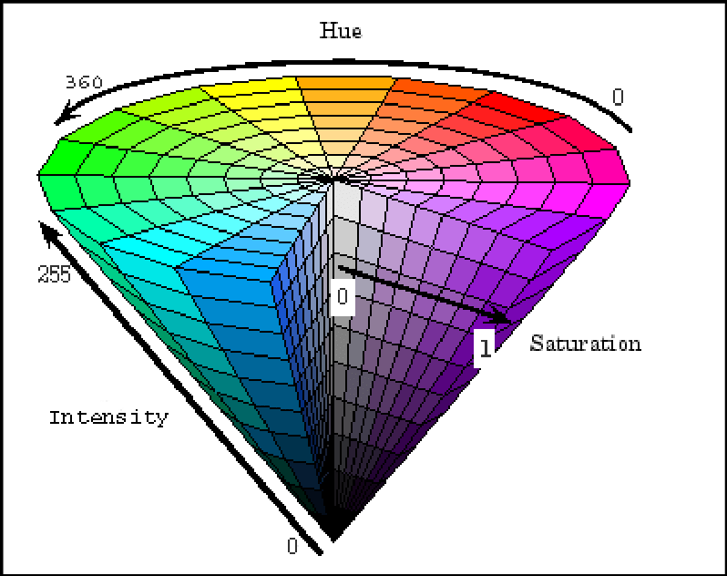
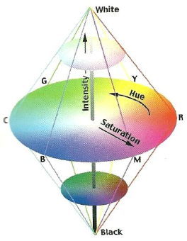

Slide 26
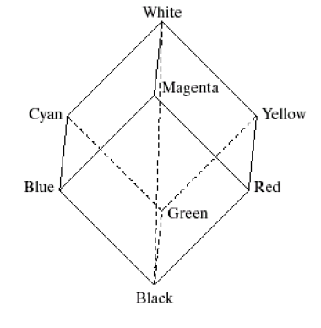
HSI Color Model
The intensity component of any color can be determined by passing a plane perpendicular to the intenisty axis and containing the color point.
The intersection of the plane with the intensity axis gives us the intensity component of the color.
The saturation of a color (percentage of white missing from the color) increases as a function of distance from the intensity axis.

Slide 27
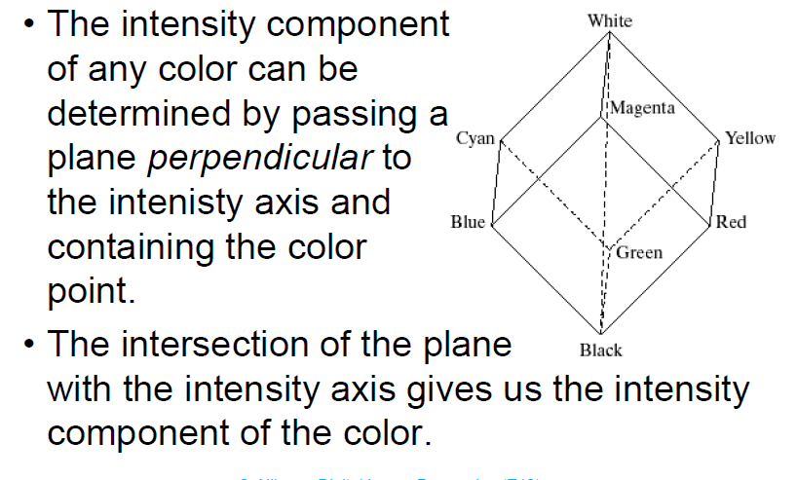
HSI Color Model

Slide 28
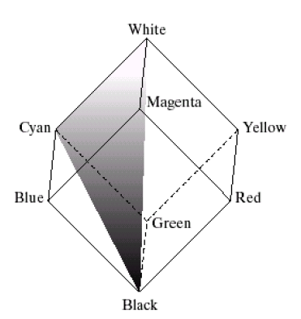
HSI, Hue & RGB
In a similar way we can extract the hue from the RGB color cube.
Consider a plane defined by the three points cyan, black and white.
All points contained in this plane must have the same hue (cyan) as black and white cannot contribute hue information to a color
By rotating the shaded plane around the intensity axis we obtain different hues.
Conclusion:
– The HSI values can be obtained from the RGB values.
– We have to work the geometric formulas.

Slide 29
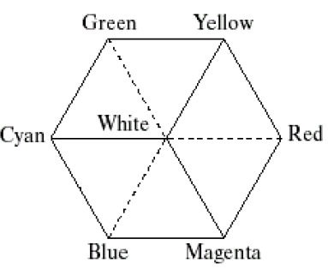
HSI Color Model
If we look straight down at the RGB cube as it was arranged previously-
we would see a hexagonal shape with each primary color separated by 120° and secondary colors at 60°from the primaries.
The HSI model is composed of a vertical intensity axis

Slide 30
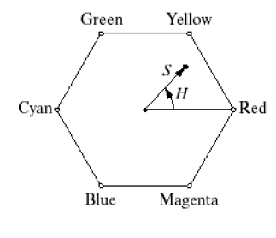
HSI Color Model
Hexagonal shape at an arbitrary color point
– The hue is determined by an angle from a reference point, usually red.
– The saturation is the distance from the origin to the point.
– The intensity is determined by how far up the vertical intensity axis this hexagonal plane sits (not apparent from this diagram).

Slide 31
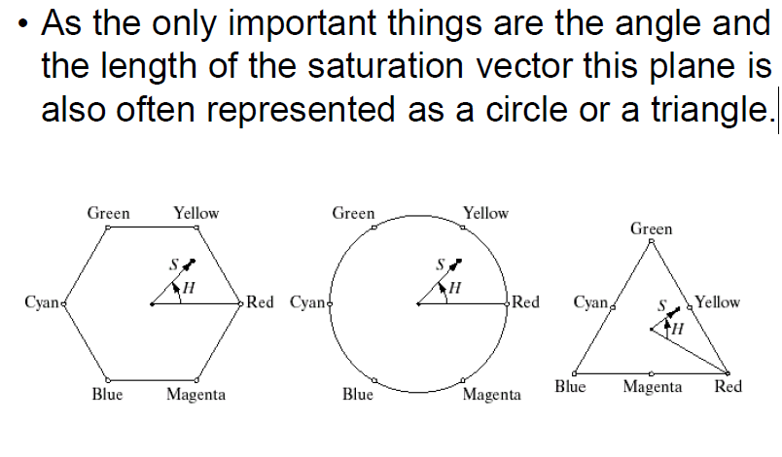
HSI Color Model

Slide 32
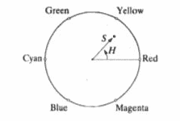
Conversion of RGB to HSI
The formula for conversion of RGB to HSI is quite complicated as compared to other color models.
The angle from the red axis gives the Hue, the length of the vector is the saturation and the intensity is given by the position of the plane on the vertical intensity axis.
The biggest application of this model is that it represents colors similarly to how the human eye senses colors.

Slide 33
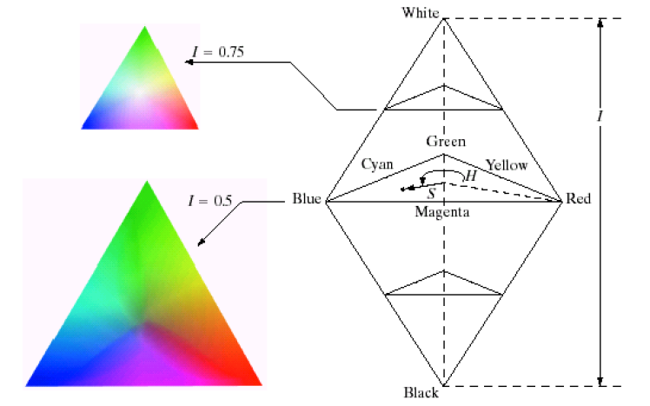
HSI Model
The HSI model, showing the HSI solid on the left, and the HSI triangle on the right, formed by taking a horizontal slice through the HSI solid at a particular intensity.
Hue is measured from red, and saturation is given by distance from the axis.
Colors on the surface of the solid are fully saturated, i.e. pure colors, and the greyscale spectrum is on the axis of the solid.

Slide 34
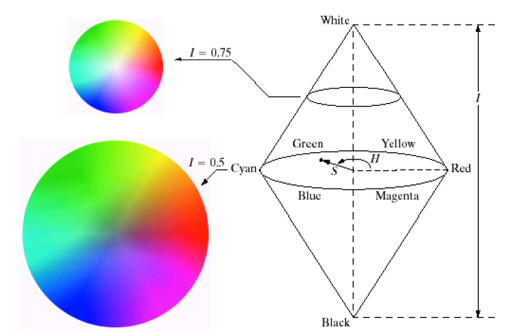
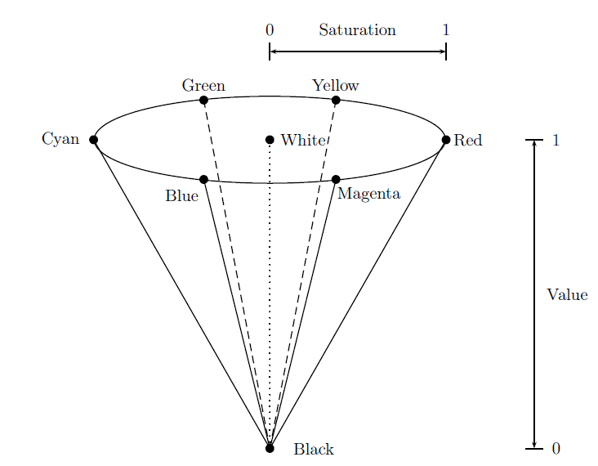
HSI Model Example

Slide 35
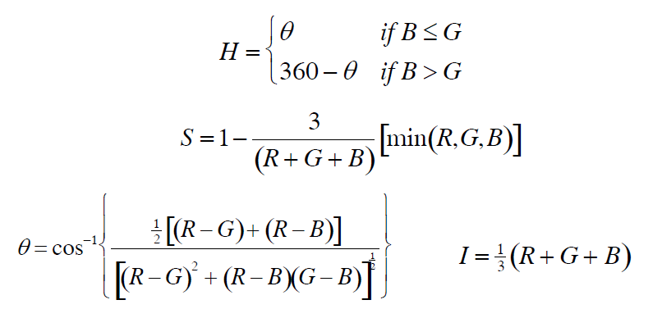
Converting From RGB To HSI
Consider RGB values normalized to the range [0; 1]
Given a color as R, G, and B its H, S, and I values are calculated as follows:-
𝛉 is measured with respect to red axis of HSI space

Slide 36
Color Image Processing
There are two types of color image processes-
Pseudocolor image processing- grayscale image to be processed.
Full color image process – the process to manipulate real color images such as color photographs.

Slide 37
Pseudocolor Image Processing
Pseudocolor (also called false color) image processing consists of assigning colors to grey values based on a specific criterion.
The principle use of pseudocolor image processing is for human visualisation.
This means assigning colours to a grey-scale image in order to make certain aspects of the image more amenable for visual interpretation
Intensity slicing and color coding is one of the simplest kinds of pseudocolor image processing.

Slide 38
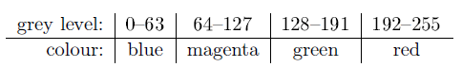
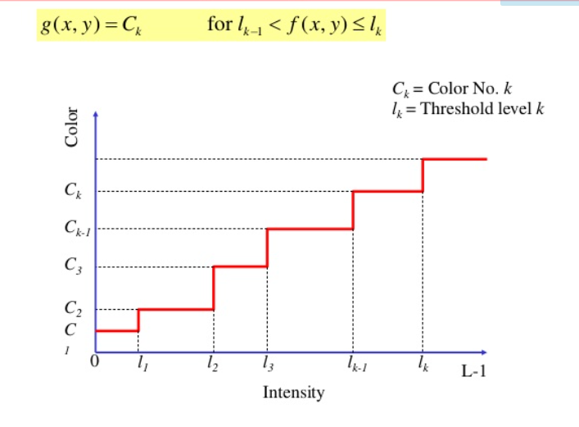
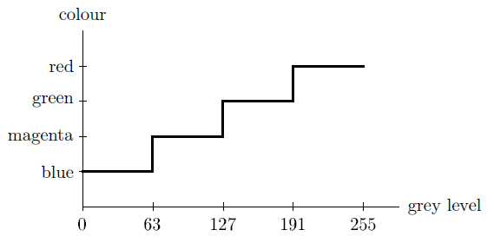
Intensity Slicing
In this method, we break up the image into various grey level ranges. We simply assign a dierent colour to each range. For example:
We can consider this as a mapping, as shown in the figure-

Slide 39
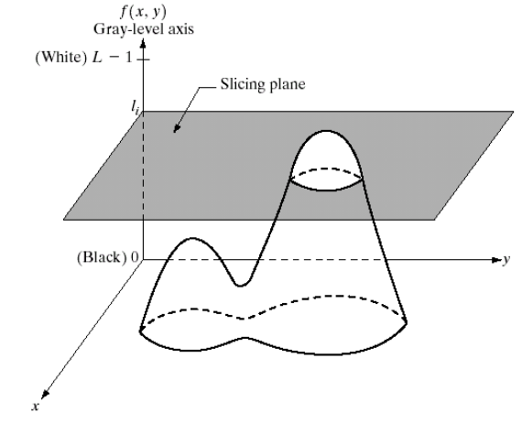
Intensity Slicing
First we consider an image as a 3D function mapping spatial coordinates to intensities (that we can consider heights).
The method can be viewed as one of placing planes parallel to the coordinate plan of the image , each plane then “slice” the function in the area of intersection
Figure shows an example of using a plane at f(x,y)=l_{i} to slice the image function at two levels.
If a different color is assigned to each side of the plane, any pixel whose intensity level is above the plane will be coded with one color, and any pixel below the plane will be coded with other
If a value is one side of such a plane it is rendered in one color, and a different color if on the other side.

Slide 40
Pseudocolor Image Processing – Intensity Slicing (cont…)
In general intensity slicing can be summarized as:
Let [0, L-1] represent the grey scale
Let l₀ represent black [f (x, y) = 0] and let l_{L-1} represent white [f (x, y) = L-1]
Suppose P planes perpendicular to the intensity axis are defined at levels l₁, l₂, …, lp
Assuming that 0 < P < L-1 then the P planes partition the grey scale into P + 1 intervals V₁, V₂,…,V_{P+1}
Grey level color assignments can then be made according to the relation:
f (x, y) = c_{k} if f (x, y) ∈ V_{k}
where c_{k} is the color associated with the k_{th} intensity level V_{k} defined by the partitioning planes at l = k – 1 and l = k

Slide 41
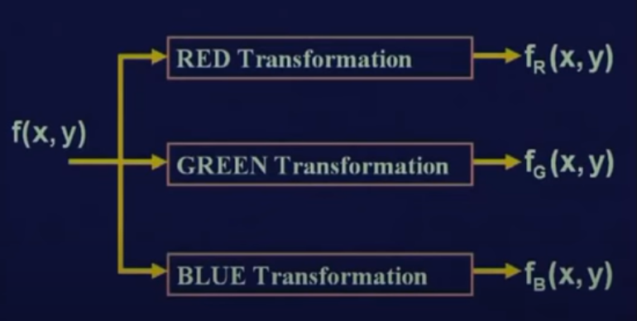
Grey to Color Transformation
If we have a gray scale image that corresponds to a single plane, we have to convert that into three different planes i.e R, G and B.
When these Red, Green and Blue planes are combined together, they gives you an interpretation of color image
f(x,y) is a gray scale image

Slide 42
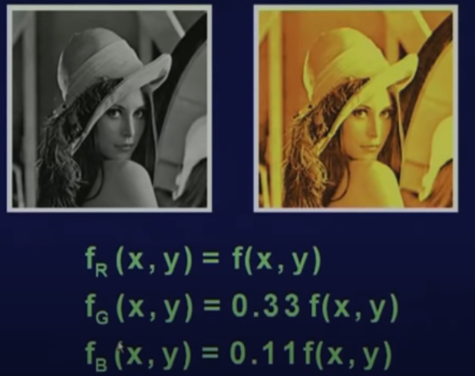
Grey to Color Transformation

Slide 43
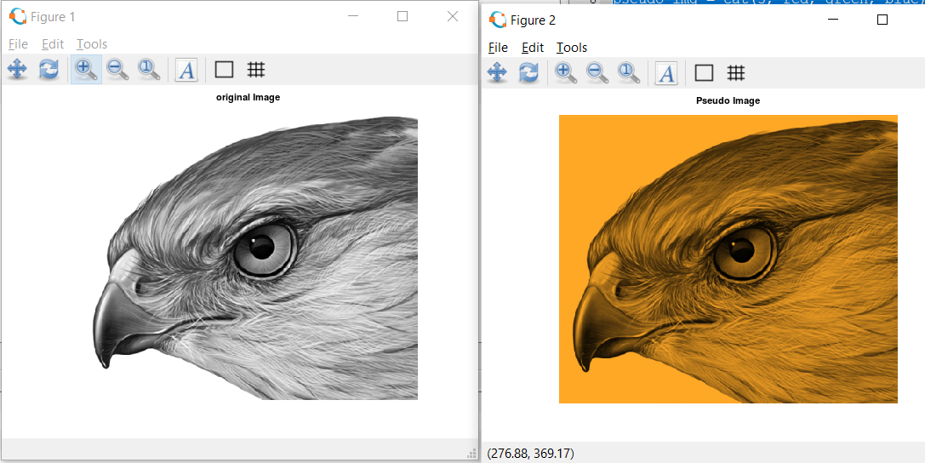
Grey to Color Transformation
pkg load image;
clear all;
img = imread('hawk1.png'); % Read image
figure, imshow(img);title("original Image");
red = img;
green=0.66*img;
blue = 0.15*img;
pseudo_img = cat(3, red, green, blue);
figure, imshow(pseudo_img), title('Pseudo Image');

Slide 44
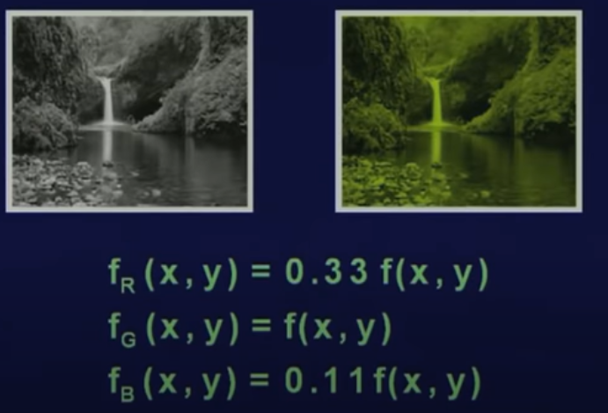
Grey to Color Transformation

Slide 45
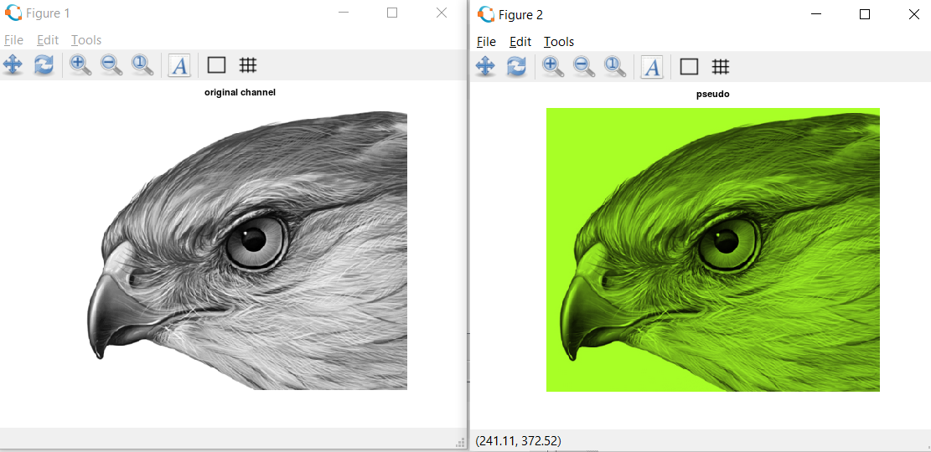
Grey to Color Transformation
pkg load image;
clear all;
img = imread('hawk1.png'); % Read image
figure, imshow(img);title("original channel");
red = 0.66 * img;
green=img;
blue = 0.15*img;
pseudo_img = cat(3, red, green, blue);
figure, imshow(pseudo_img), title('pseudo');

Slide 46
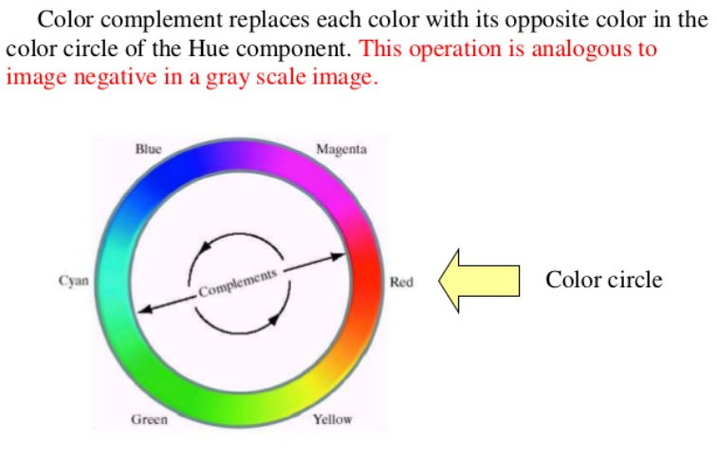
Color Transformation- Color Complements
For example, red color ( 255, 0, 0) is replaced with cyan color ( 0, 255, 255 ). blue color ( 0, 0, 255 ) is replaced with yellow color ( 255, 255, 0).
here, cyan is complementary color for red and yellow are complementary color for blue.
dfgdgfgdfg

Slide 47
Find the color complement of [120, 80, 140]

